Slide 1
IMPORTANT! – How to Submit
You can change CMake file, but make sure that final executable file locates at build (or bin) folder.
Do not remove executable file! (main.exe or main)
We will first run your executable file and then compile if it does not work.
Please remove unnecessary files to reduce a size of the submission!
(especially ‘.vs’, ‘out’ folder and .ilk and.pdb file for Visual Studio users)

Slide 2
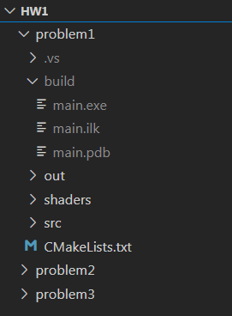
IMPORTANT! – How to Submit
<folder structure>
graphicsprogramming2022
└ assignments
└ lab1
└ lab2
└ hw1
└ hw2
└ glad.c
└ dlls
└ includes
└ lib
Submit this folder only!
Remove red boxes!

